Slide 1
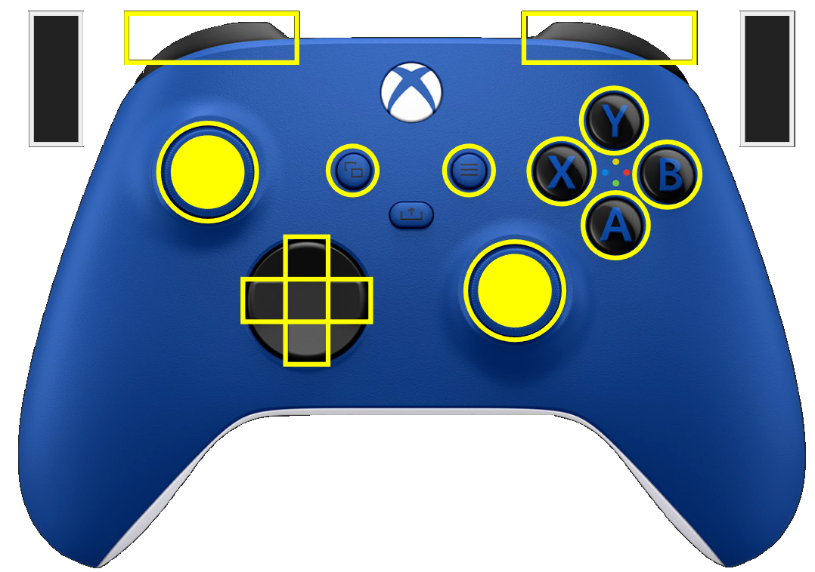
Driver
Override some commands
Goto Ladder
Approach Depot
Field-Relative
Robot-Relative
Approach Outpost
Right Bump Drive
Bumper
Bumper
Trigger
Trigger
Left Bump Drive
back
start
Drive
Reset Telemetry
Extend Climber
Brake
Retract Climber
Rotation
(L-CCW, R-CW)
Climber
(Tweak Up)
Climber(Tweak Down)
Get Off Fuel
One-Shot
Ladder Align
While Pressed

Slide 2
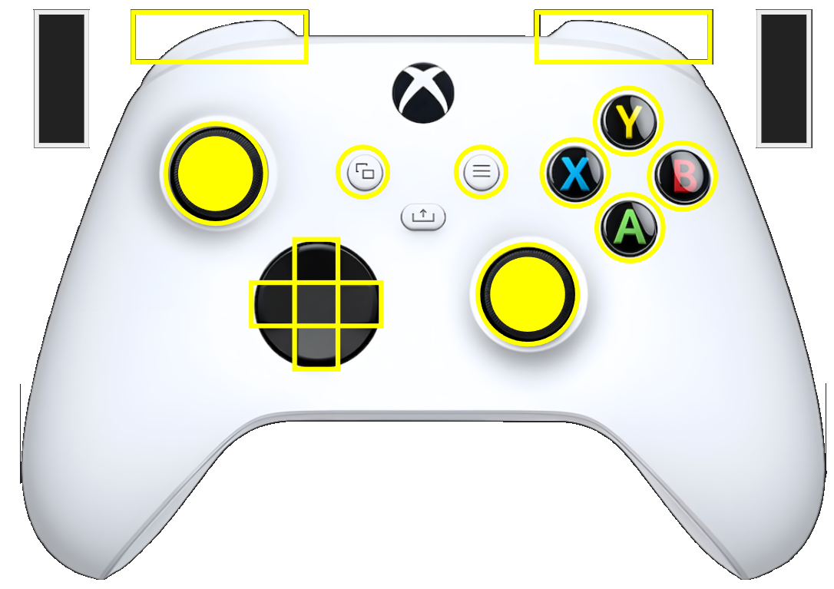
Override some commands
Both of these also operates indexer
Shooter
Goto a good location, aim, engage brake, and shoot all fuel
Bumper
Bumper
Aim & Shoot
Intake Fuel
Trigger
Trigger
Just Shoot
(back pressed)
Maintains aim and shoot all fuel. Can be moving…
back
start
Empty Fuel also operates indexer in reverse
Empty Fuel
(back pressed)
Retract Intake (up)
Brake
Deploy Intake (down)
Tweak Intake (down)
Tweak Intake (up)
Goto Climb
One-Shot
Approach Depot
Reset Position
While Pressed
Approach Outpost
Ladder Align
Get Off Fuel

Slide 3
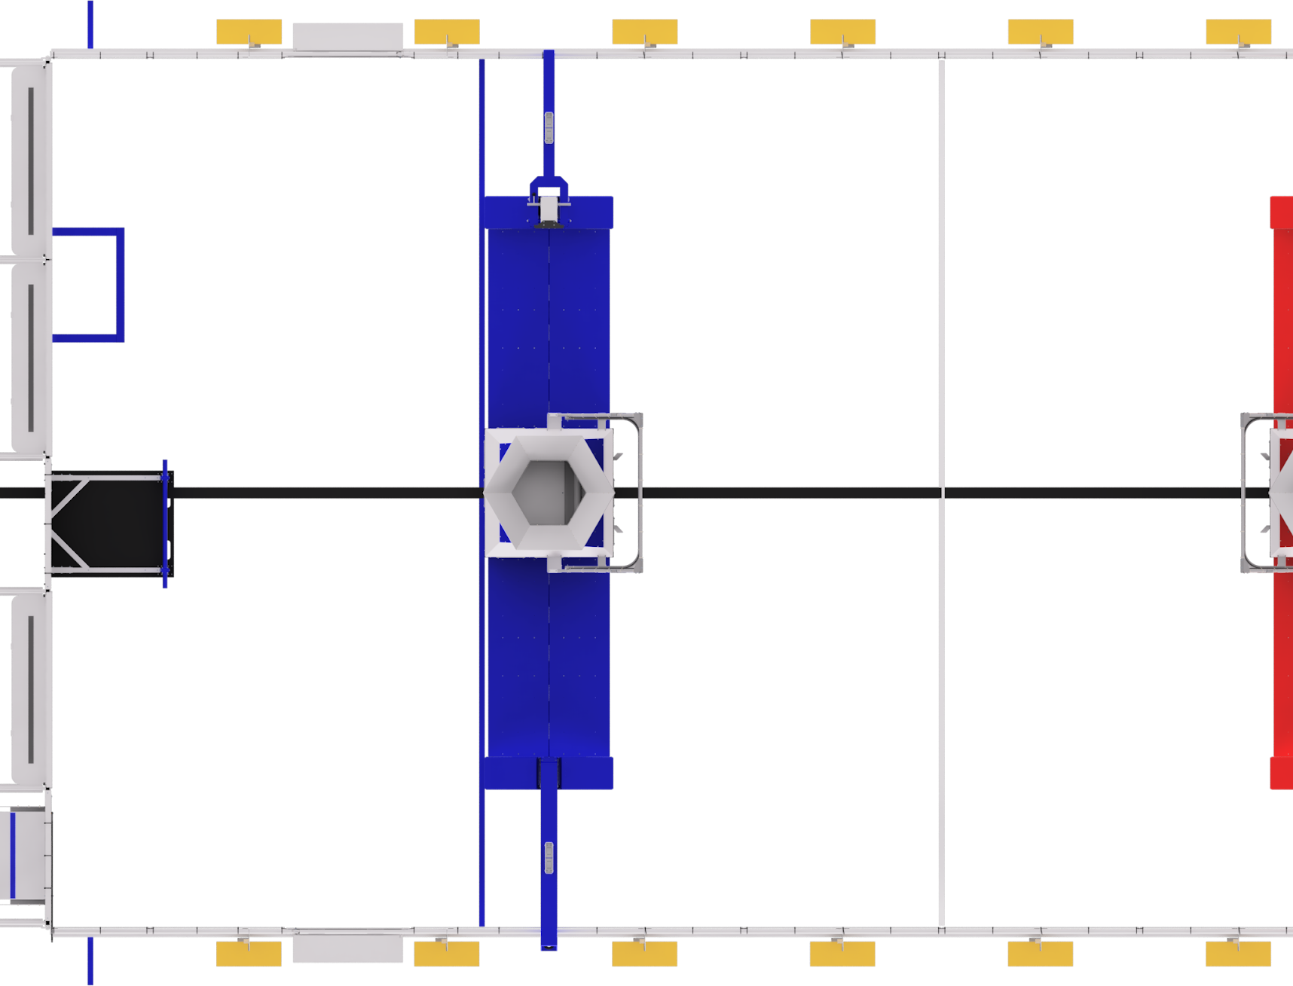
Autonomous Start & End Positions
15’ – 2”
11’-11”
Alliance Zone
Neutral Zone
S1
13’- 3”
Coordinates
(x, y) – meters
S1- 3.6, 7.4
S2- 3.6, 5.2
S3- 3.6, 2.8
S4- 3.6 , 0.7
C1- 1.3, 4.6
C2- 0.9, 2.9
C3-
S2
C1
C3
C2
S3
G303 – Robot Placement
D. its BUMPERS overlap their ROBOT STARTING LINE,
E. it’s not contacting the BUMP
26’- 7”
S4

Slide 4
Crossing & Game Piece Positions
15’ – 2”
11’-11”
Alliance Zone
Neutral Zone
Coordinates
(x, y, theta) –
A1 – 3.4 , 5.5, 90
N1 – 5.8, 5.5, 30
A2 – 3.4, 2.5, -90
N2 – 5.8, 2.5, -30
D1-
D2-
O1-
13’- 3”
D1
D2
A1
N1
Linked Waypoint names follow the convention.
PT – PATH
So, for the A1-Point in the A1→ A2 direction, link name is
A1-A1-N2
This is so we can control the ‘theta’ value depending on the direction.
Bump Crossing Speed: 2.0 m/s
A2
N2
26’- 7”
O1

Slide 5
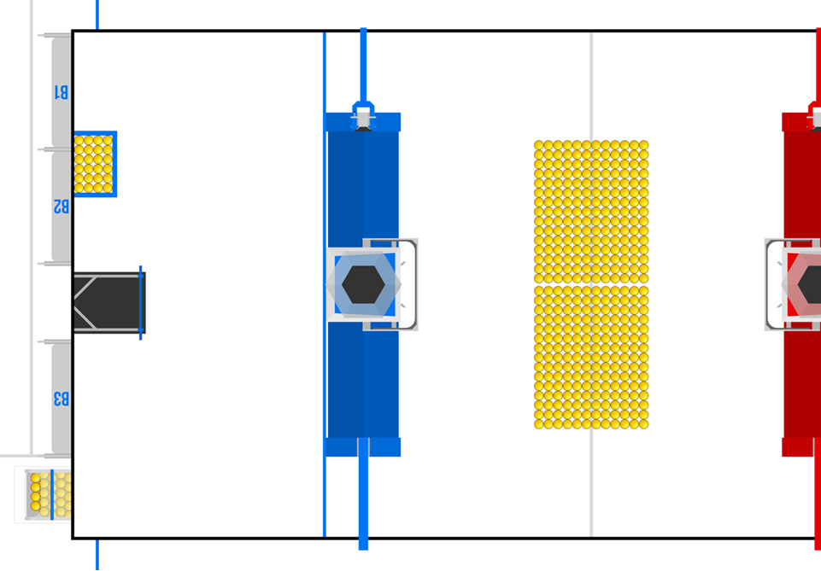
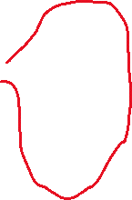

Same Bump Routes
15’ – 2”
11’-11”
Alliance Zone
Neutral Zone
These are routes where you enter and leave via the same bump
13’- 3”
Goal is to enter from the perimeter side, collect fuel, and return across same bump.
A1
N1
The robot stays in the alliance’s ‘side’ of the neutral zone but is slightly skewed to push balls toward the alliance side.
Path is name for the neutral side entry. Either : N1-Sweep
or
N2-Sweep
A2
N2
26’- 7”

Slide 6
Other Bump Routes
15’ – 2”
11’-11”
Alliance Zone
Neutral Zone
These are routes where you enter on one bump, but exit on the other
13’- 3”
A1
N1
A2
N2
26’- 7”

Slide 7
15’ – 2”
11’-11”
Alliance Zone
Neutral Zone
13’- 3”
26’- 7”

Slide 8
15’ – 2”
11’-11”
Alliance Zone
Neutral Zone
13’- 3”
26’- 7”

Slide 9
15’ – 2”
11’-11”
Alliance Zone
Neutral Zone
13’- 3”
26’- 7”

